Slide 1
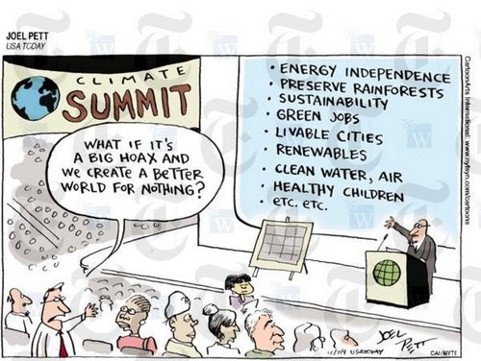

Slide 2
Optimal Climate Policy
International agreements
First-best climate policy
Ancillary benefits
Time discounting
Uncertainty
Equity

Slide 3




Two criterion emissions, G and A, measured as emission reductions.
Benefits, B, of emission reduction:
$$B=αA+χG$$
Emission controls, R and S, affect both:
$$G=πS+ρR$$
$$A=σS+τR$$
Costs, C, of emission reduction:
$$C=0.5κS^{2}+0.5λR^{2}$$
Rework benefits:
$$B=α\left(σS+τR\right)+χ\left(πS+ρR\right)=S\left(ασ+χπ\right)+R\left(ατ+χρ\right)$$

Slide 4

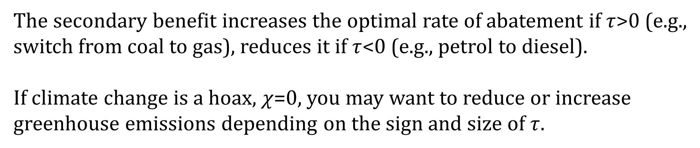
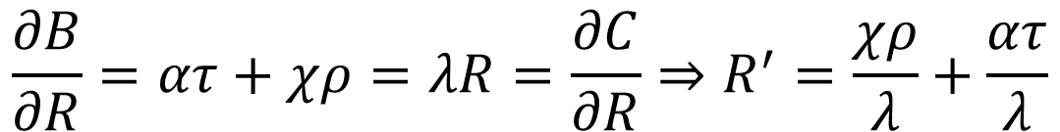
Benefits, B, of emission reduction:
$$B=α\left(σS+τR\right)+χ\left(πS+ρR\right)=S\left(ασ+χπ\right)+R\left(ατ+χρ\right)$$
Costs, C, of emission reduction:
$$C=0.5κS^{2}+0.5λR^{2}$$
Optimal control for R:
$$\frac{∂B}{∂R}=ατ+χρ=λR=\frac{∂C}{∂R}⇒R^{′}=\frac{χρ}{λ}+\frac{ατ}{λ}$$
The secondary benefit increases the optimal rate of abatement if $τ$>0 (e.g.,
switch from coal to gas), reduces it if $τ$<0 (e.g., petrol to diesel).
If climate change is a hoax, $χ$=0, you may want to reduce or increase
greenhouse emissions depending on the sign and size of $τ$.

Slide 5
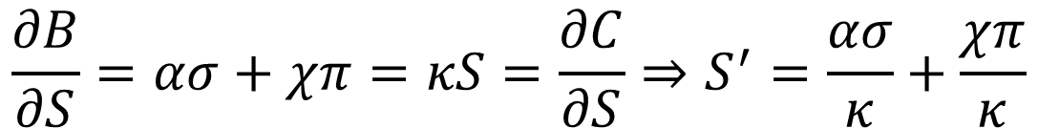
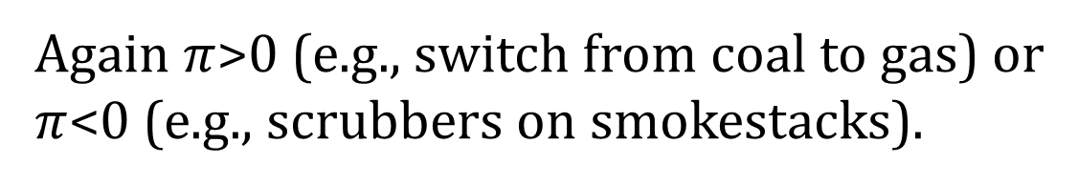
Optimal control for S:
$$\frac{∂B}{∂S}=ασ+χπ=κS=\frac{∂C}{∂S}⇒S^{′}=\frac{ασ}{κ}+\frac{χπ}{κ}$$
Again $π$>0 (e.g., switch from coal to gas) or
$π$<0 (e.g., scrubbers on smokestacks).

Slide 6
Secondary benefits
If greenhouse gas emission reduction helps solving other problems (air pollution, energy security), then we should do more of it
However, it can also make these problems worse
Other problems do not justify a lot of greenhouse gas emission reduction as greenhouse gas emission reduction would be a clumsy way to solve other problems

Slide 7
Now make the secondary benefits less than linear.
Benefits, B, of emission reduction:
$$B=αA+χG$$
Emission controls, R and S, affect both:
$$G=πS+ρR$$
$$A=σS+τR−ψRS=σS+\left(τ−ψS\right)R$$
Costs, C, of emission reduction:
$$C=0.5κS^{2}+0.5λR^{2}$$
Rework benefits:
$$B=α\left(σS+τR−ψRS\right)+χ\left(πS+ρR\right)=S\left(ασ+χπ−αψR\right)+R\left(ατ+χρ\right)$$

Slide 8
Benefits, B, of emission reduction:
$$B=α\left(σS+τR−ψRS\right)+χ\left(πS+ρR\right)$$
Costs, C, of emission reduction:
$$C=0.5κS^{2}+0.5λR^{2}$$
Optimal control for R:
$$\frac{∂B}{∂R}=ατ+χρ−αψS=λR=\frac{∂C}{∂R}⇒R=\frac{ατ+χρ}{λ}−\frac{αψ}{λ}S$$
$$\frac{∂B}{∂S}=ασ+χπ−αψR=κS=\frac{∂C}{∂S}⇒S=\frac{ασ+χπ}{κ}−\frac{αψ}{κ}R$$

Slide 9

Benefits, B, of emission reduction:
$$B=α\left(σS+τR−ψRS\right)+χ\left(πS+ρR\right)$$
Costs, C, of emission reduction:
$$C=0.5κS^{2}+0.5λR^{2}$$
Optimal control for R:
$$\frac{∂B}{∂R}=ατ+χρ−αψS=λR=\frac{∂C}{∂R}⇒R=\frac{ατ+χρ}{λ}−\frac{αψ}{λ}S$$
$$\frac{∂B}{∂S}=ασ+χπ−αψR=κS=\frac{∂C}{∂S}⇒S=\frac{ασ+χπ}{κ}−\frac{αψ}{κ}R$$
$$R^{′}=\frac{\left(ατ+χρ\right)κ−(ασ+χπ)αψ}{λκ−{α^{2}ψ}^{2}}$$

Slide 10
Secondary benefits
If greenhouse gas emission reduction helps solving other problems (air pollution, energy security), then we should do more of it
However, it can also make these problems worse
Other problems do not justify a lot of greenhouse gas emission reduction as greenhouse gas emission reduction would be a clumsy way to solve other problems
Secondary benefits shrink with policies aimed at these problems

Slide 11
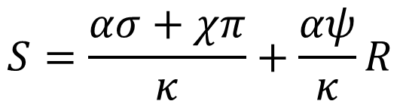
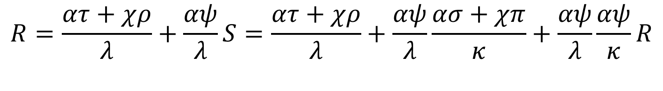
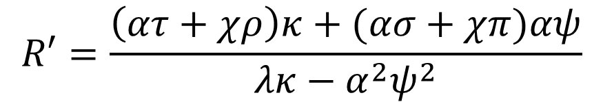
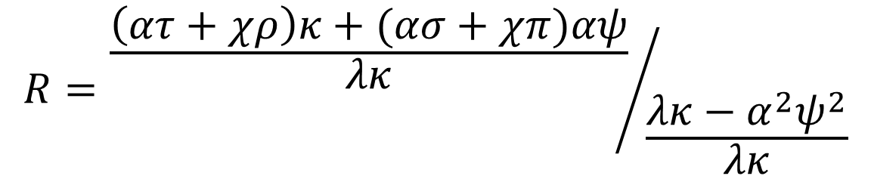
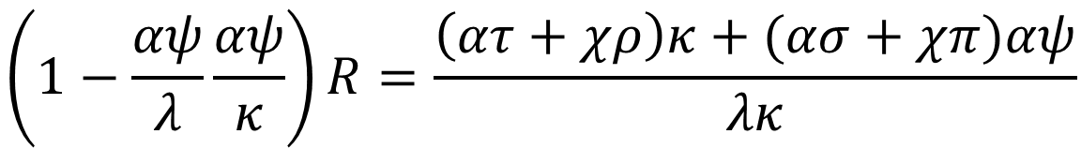
$$S=\frac{ασ+χπ}{κ}+\frac{αψ}{κ}R$$
$$R=\frac{ατ+χρ}{λ}+\frac{αψ}{λ}S=\frac{ατ+χρ}{λ}+\frac{αψ}{λ}\frac{ασ+χπ}{κ}+\frac{αψ}{λ}\frac{αψ}{κ}R$$
$$\left(1−\frac{αψ}{λ}\frac{αψ}{κ}\right)R=\frac{\left(ατ+χρ\right)κ+(ασ+χπ)αψ}{λκ}$$
$$R={\frac{\left(ατ+χρ\right)κ+(ασ+χπ)αψ}{λκ}}/{\frac{λκ−α^{2}ψ^{2}}{λκ}}$$
$$R′=\frac{\left(ατ+χρ\right)κ+(ασ+χπ)αψ}{λκ−α^{2}ψ^{2}}$$

